Slide 1
Quantum Computing
Stanley Ngugi

Slide 2
Objectives
To understand the general working mechanism of a quantum computer.
To identify the potential problems that quantum computers can solve
To find out how to harness the power of a quantum computer.
To review the potential impact of quantum computers in cybersecurity
To review the challenges that hinder the construction of quantum computers.

Slide 3
Introduction
Classical computers store information as bits that each take a value of 0 or 1. At the most basic level, everything a computer does is just manipulating the values of those bits with small electrical voltages at hardware level.
A quantum computer’s equivalent to a bit is known as a qubit which can either exist as both a 1 and 0 simultaneously.
This special state of being simultaneously 0 and 1 is known as superposition and allows large amounts of information to be represented using a few quantum particles.
Qubits can be linked together to form a series of qubits which can represent different things simultaneously.

Slide 4
Quantum Computers VS Classical Computers
Quantum Computers are not a new generation of computers.
We need classical computers to work with quantum computers
Quantum computers will not solve every computation faster than the classical computer.
Quantum computers will solve Intractable problems
Quantum computers will not replace classical computers

Slide 5
How Quantum Computers interact with classical computers
Quantum computer will be used as a coprocessor to a classical computing system, much in the same way that a graphics processing unit (GPU) performs specialized operations that the traditional central processing unit (CPU) cannot do.
A quantum processing unit (QPU). A QPU includes the:
QRAM (register + gates)
Quantum control unit (QCU)
Classical controller interface which defines the interaction between the host CPU and the QPU

Slide 6
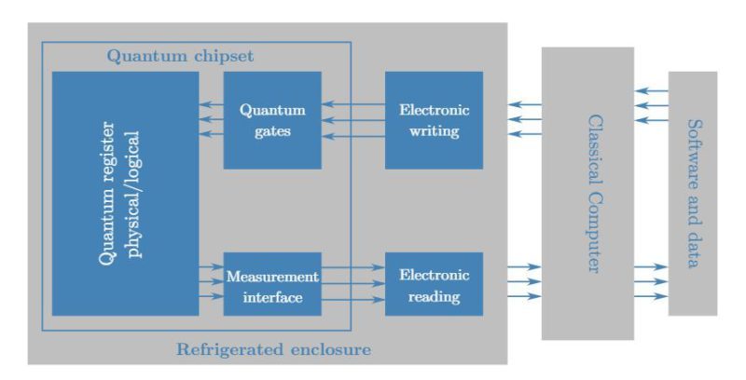
How Quantum Computers interact with classical computers
source: IEEE Explore journal article

Slide 7
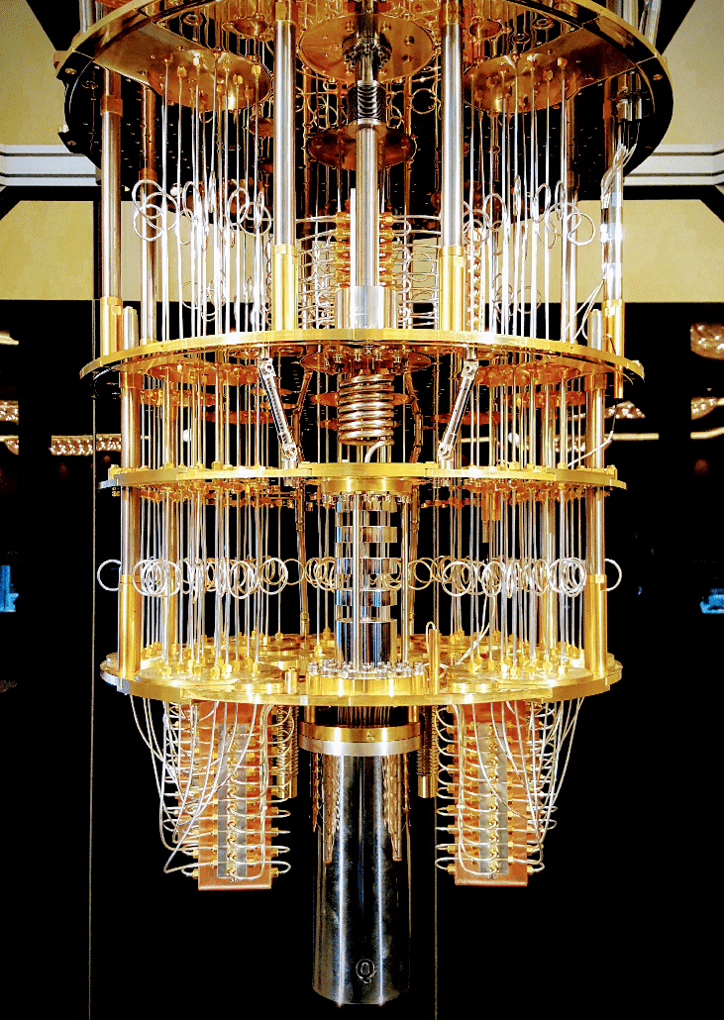
The
Steampunk
Chandelier

Slide 8
The Steampunk Chandelier
Qubits can only be detected and manipulated at extremely low energy levels and at temperatures close to absolute zero.
Cryogenic refrigeration systems with multiple stages of cooling and numerous cryogenic cables provide this environment.
Rods are gold-plated brass because gold reflects away heat in the form of infrared radiation
Cryogenic chambers prevent external interference from microwaves, magnetic fields and thermal radiation
The actual processor, called the payload, is in a microchip-like package at the bottom of the assembly in a part called the cryostat

Slide 9
How to integrate Quantum Computers into your computer system set up
In-house Set up
Quite expensive
Delicate to maintain
Risk of a being outdated
Cloud Quantum Computer
Trust, but verify

Slide 10
How does a developer interact with the quantum computer?
To program a quantum computer, the programmer will send the algorithms via a host system, typically called “host processor”.
A host processor is a classical computer which has a high bandwidth connection to the QCU. The host runs a conventional operating system to allow the user interaction with the quantum processor.

Slide 11
Development Environments
IBM has QISKIT - An open source SDK for working with IBM's Quantum Computers
Google has CIRQ - An open source Software library for writing, manipulating and optimizing quantum circuits
Microsoft has Q# & Quantum Development Kit - A high level quantum focused PL for quantum program development

Slide 12
…
Quantum computers are still in infancy and top companies such as google, IBM and Microsoft are racing to make the most efficient quantum computers

